Slide 1
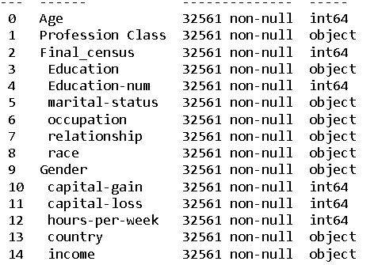
Project : Income Prediction
Data set Details
No of rows: 32561
No of Columns: 15
Target Variable: 1
Predictor variable : 14

Slide 2
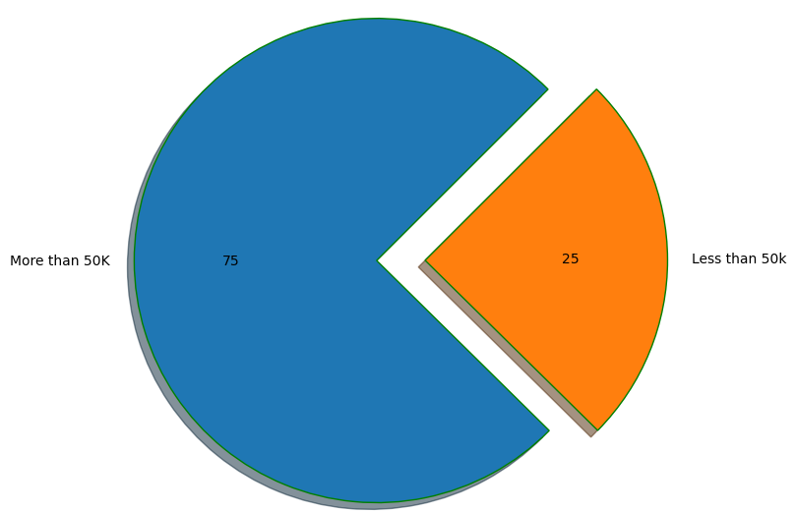
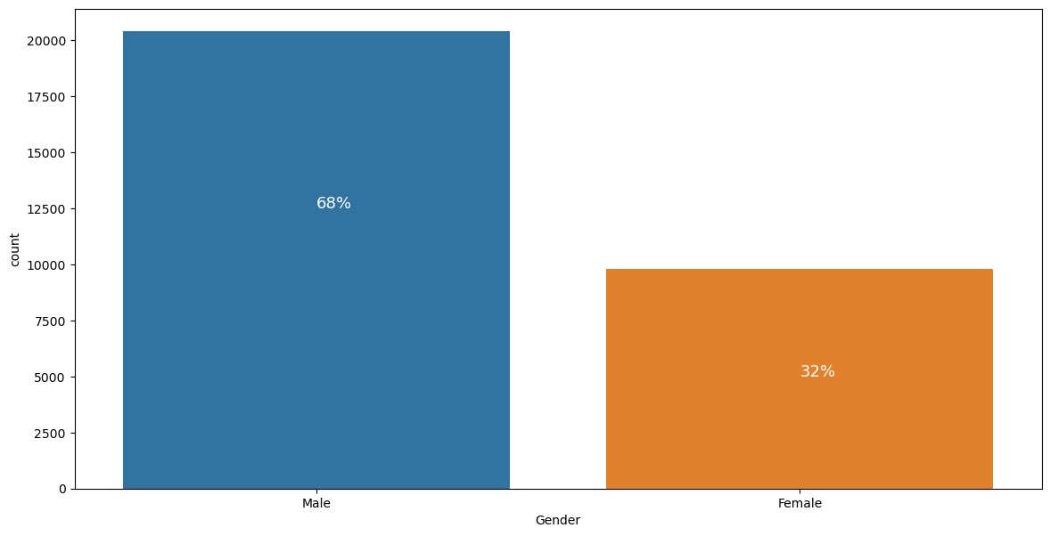
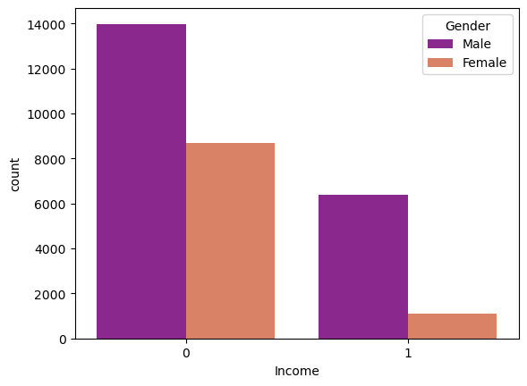
Target variable is distributed in 75-25 ratio
75% population are earning less than 50k
25% population are earning more than 50 k
1. Gender distribution isn't equal, and clearly this dataset is male dominant
2. only 32% population is females which leads to the fact that at the time of this dataset creation, females aren't sufficiently educated and salaried.

Slide 3
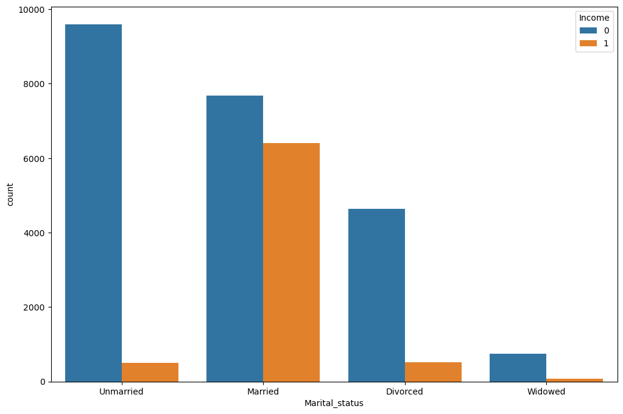
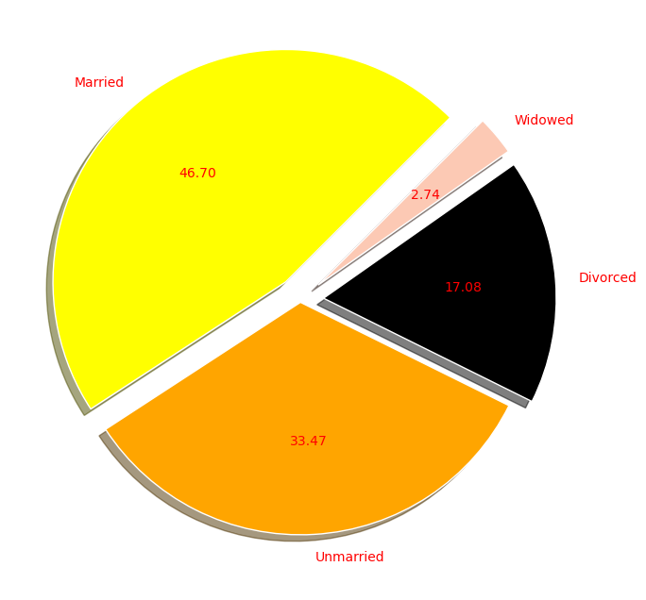
0 – Less than 50K
1 – More than 50K
1. Most Unmarried Population are earning less than 50K
2. When it comes to married people, both income range is almost equally distributed
3. Those who are divorced may not taking higher education due to mental instability due to which they are getting less salary
4. Widowed are barely earning more than 50K

Slide 4
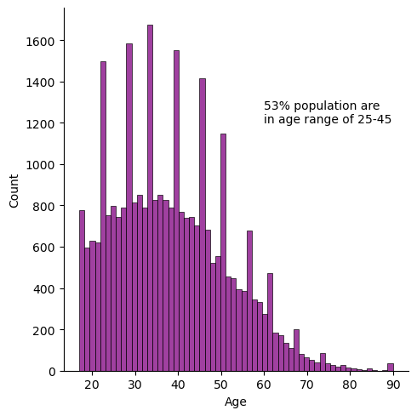
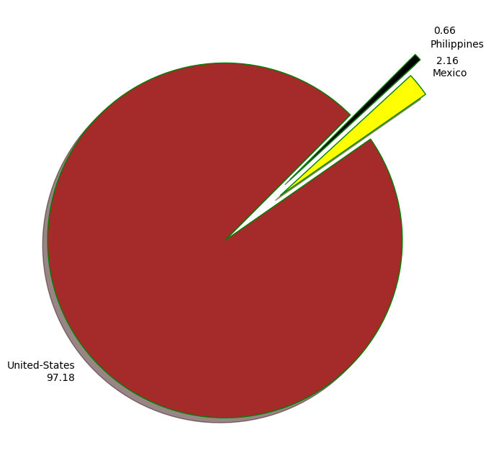

Slide 5
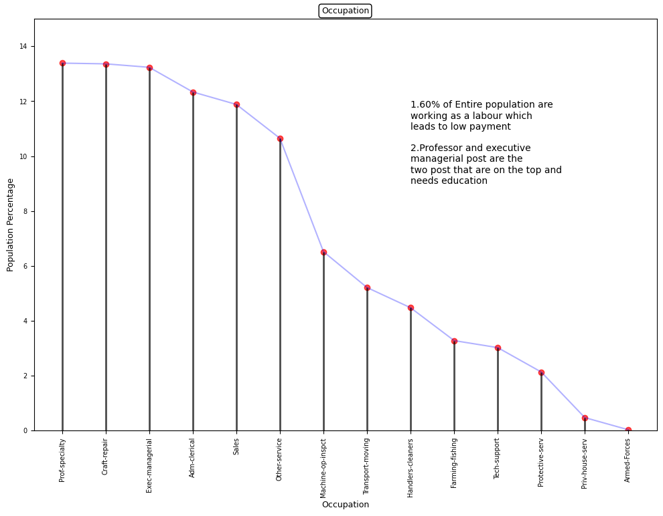

Slide 6
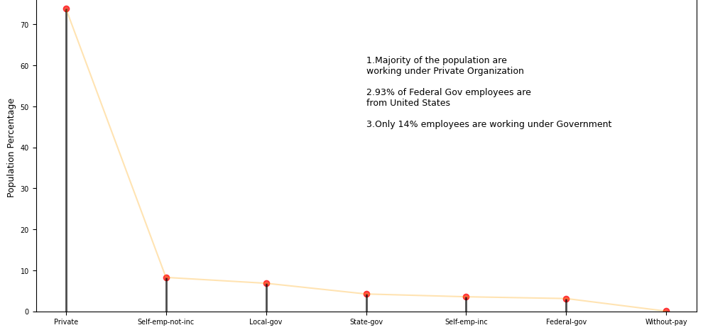
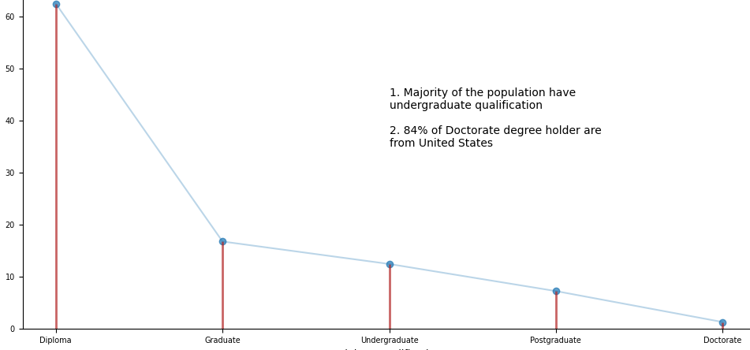

Slide 7
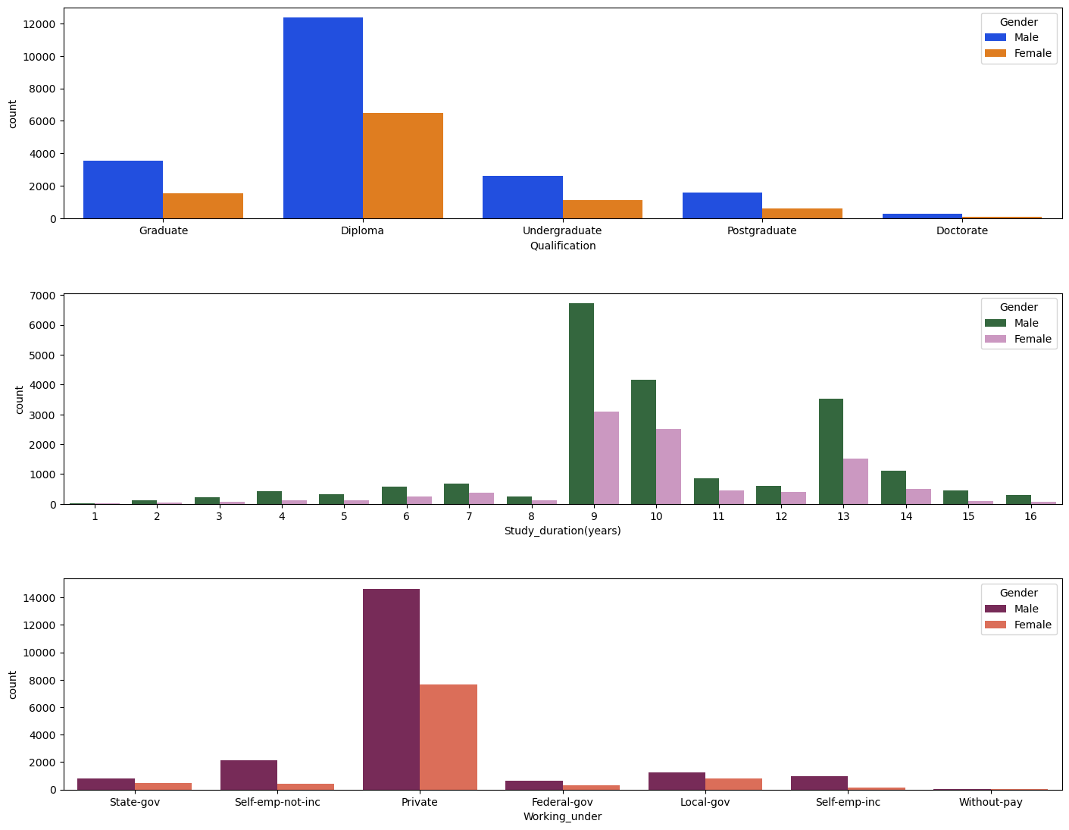
1. Male are more inclined to the study than female
2. Female mostly have education below Graduate level
3. Female are more interested in taking short duration degree like diploma than to do graduation and further
4. The population of men who have less than graduate degree is higher than men with other degree, this may happened because most men have started working early as a labor. Maybe at those time male are more focused on earning rather than studying. We can verify this statement with 2nd graph in which we can see that most of the population have invested only 9-10 years of their life in education
5. Most of the population are working in Private sector
6. Only 8.5% population are not earning any money(fall under self-emp-not-inc & without-pay) and rest 91% population are earning.

Slide 8
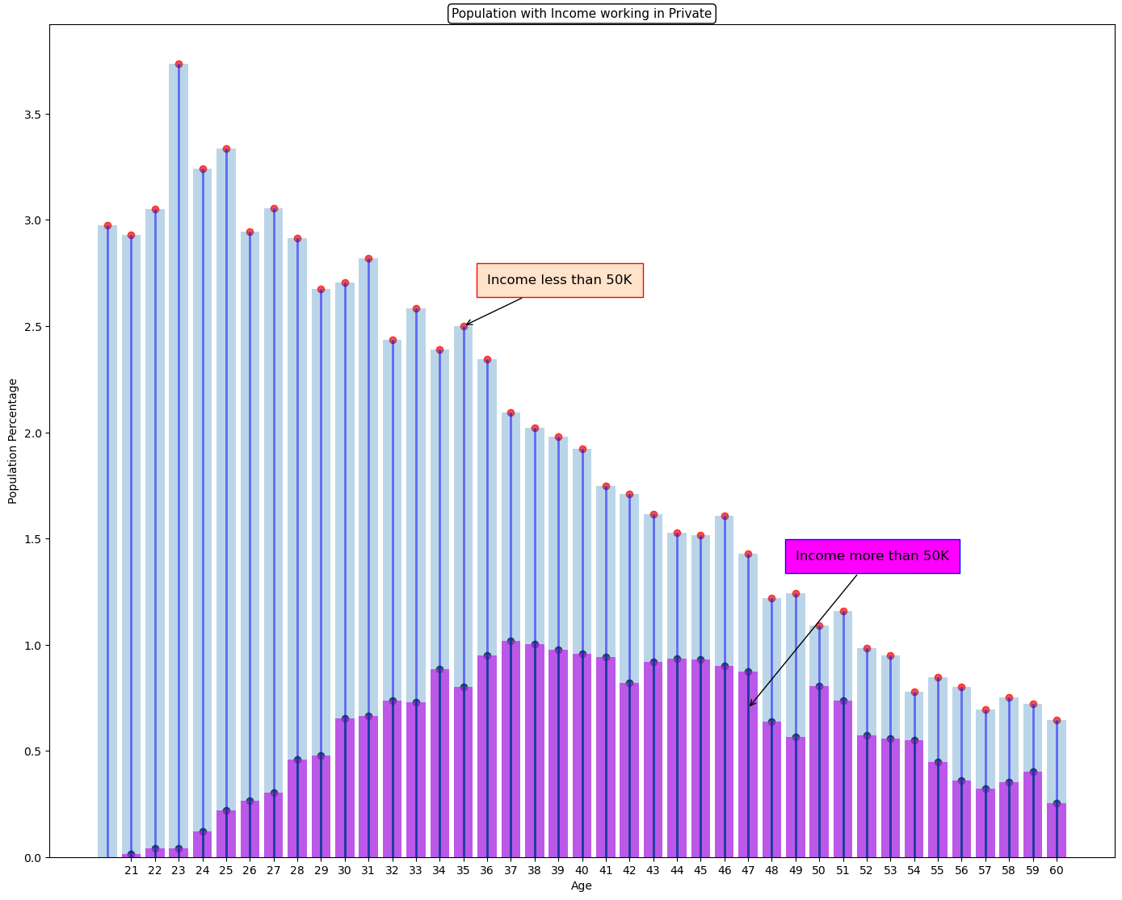

Slide 9
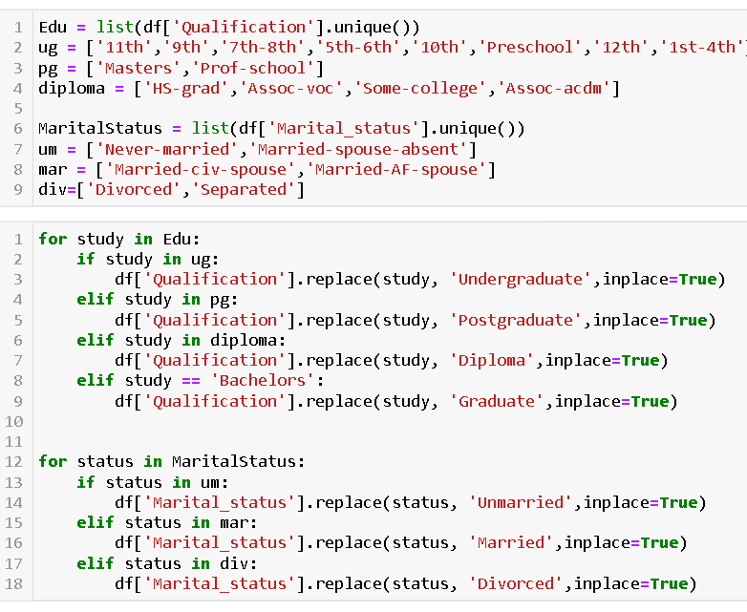
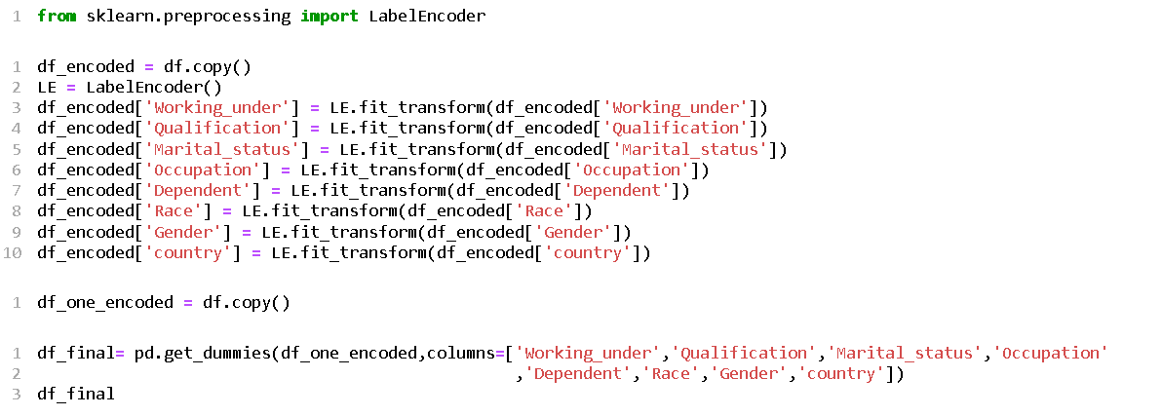
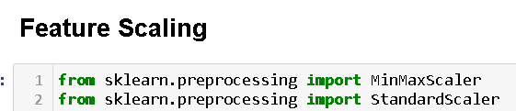
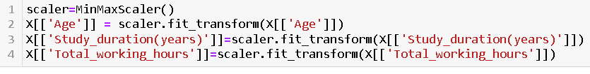
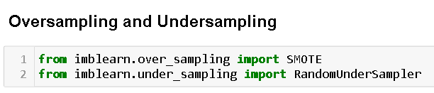
Data Processing
I have both the data for model building but achieved more accuracy in One-Hot-Encoding
I have rename some columns as well as rename some values too for my convinience
As the Target variable is distributed in 75-25 ratio, I also tried Oversampling and Undersampling

Slide 10

Model And Performance
Model | Training Accuracy | Testing Accuracy | Recall – 0 | Recall-1 | F1 Score Class 0 | F1 Score Class 1
Logistic Regression | 83.2 | 83 | 92 | 57 | 89 | 63
SVM | 83.4 | 82.4 | 92 | 54 | 89 | 61
Decision Tree Classifier | 81.52 | 81.46 | 95 | 42 | 88 | 54
KNN | 85 | 83.4 | 90 | 63 | 89 | 66
Random Forest classifier | 82 | 82 | 94 | 46 | 89 | 57
XGBoost | 86 | 84 | 92 | 62 | 90 | 67
Logistic Regression with Oversampling | 83 | 80 | 79 | 81 | 85 | 67
KNN with Oversampling | 84.3 | 78.35 | 77 | 83 | 84 | 67
XGBoost With Oversampling | 90 | 83 | 87 | 71 | 88 | 68
Logistic Regression with Under sampling | 81 | 79 | 77 | 85 | 85 | 68
KNN with Under sampling | 84 | 80 | 82 | 72 | 84 | 64
XGBoost With Under sampling | 87 | 79 | 77 | 85 | 84 | 68
** All Numbers are in percentage %

Slide 11
Conclusion
Best Model with use of Oversampling -- XGBoost
Best Model with use of Undersampling – Logistic Regression & XGBoost
Best Model without any sampling Modification – XGBoost
Overall best Model :-XGBoost With Oversampling
Training score – 90
Testing Score – 83
Recall class 0 – 87
Recall class 1 – 71
F1 score class 0 – 88
F1 score class 1 -- 68

